Slide 1
Data Structures Workshop
Day 18

Slide 2
Workshop Outline
Exam 2 Content Recap:
Recursion
Stacks
Queues
Sorting Algorithms
Heaps
Hashing

Slide 3
Exam 2 Point Distribution
Stacks → 28 pts
Queues → 27 pts
Hashing → 14 pts
Sorting → 14 pts
Heaps → 8 pts
Recursion → 9 pts

Slide 4
Quick Reminders
Lots of content on Exam 2, so be sure to study accordingly
More code implementation than Exam 1, be mindful of time
Something is better than nothing (partial credit!)

Slide 5
Stacks

Slide 6
What To Know
What are Stacks? (Understand Theory)
Implementations as Linked Lists and Arrays
Infix/Postfix Notation
Infix to Postfix (Tracing and Code)
Evaluate Postfix (Tracing and Code)
Postfix to Infix (Will Cover Today)
Practice Problems We’ve Covered
Reverse String w/ Stack
validParanthesis()
balancedBrackets()
More Practice Problems in Exam 2 Review (posted later this week)

Slide 7
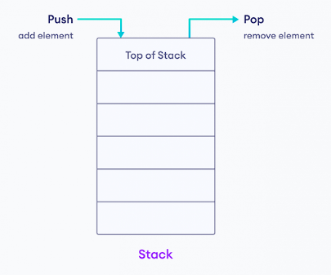
What is a Stack?
The stack data structure is a type of container that follows the “LIFO” principle (“Last In, First Out”), where elements are inserted and extracted from the end of the container.
Inserting elements will add to the “top” of the stack, while removing elements will remove the most recently added one to the stack (A.K.A. the “top” of the stack).
Most commonly implemented using Linked Lists or the STL C++ Library

Slide 8
Infix to Postfix
Logic:
Iterate through string, character by character
If the character is an operand, output
If the character is an operator, push to stack (based on rules)
If empty, simply push
If priority of operator greater than top of stack, push
If priority of operator less/equal than top of stack, pop until you meet condition (b)
After you reach end of string, pop out rest of elements of stack until stack is empty

Slide 9
Postfix Evaluation
Iterate through string
If the character is an operand, push it to the stack
If the character is an operator:
Pop two elements from stack
[secondPopped] [operator] [firstPopped]
Push result back into stack
Continue until you reach the end of the string and return whatever is at the top of the stack

Slide 10
Postfix to Infix
Iterate through string
If the character is an operand, push to stack
If the character is an operator:
Pop two elements from stack
Create Infix expression and push the expression to stack
“( [secondPopped] + [operator] + [firstPopped] )”
Continue until you reach the end of the string and return whatever is at the top of the stack

Slide 11
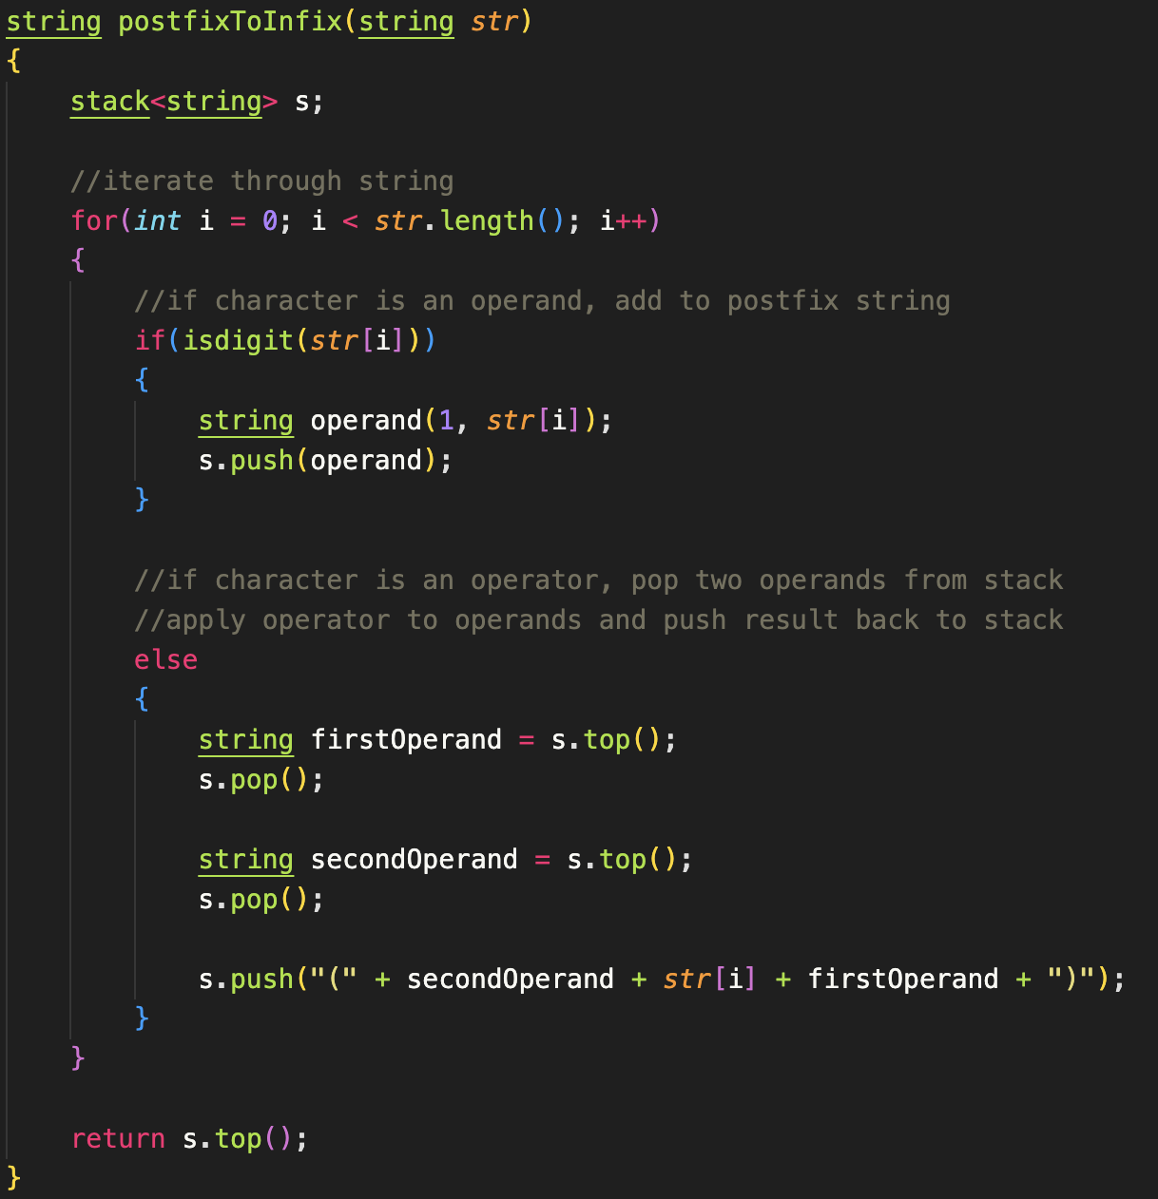
Solution

Slide 12
Queues

Slide 13
What To Know?
What are Queues? (Understand Theory)
Implementations as Linked Lists and Arrays
Priority Queues
Round Robin
Implementation
Practice Problems We’ve Covered
More Practice Problems in Exam 2 Review (posted later this week)

Slide 14
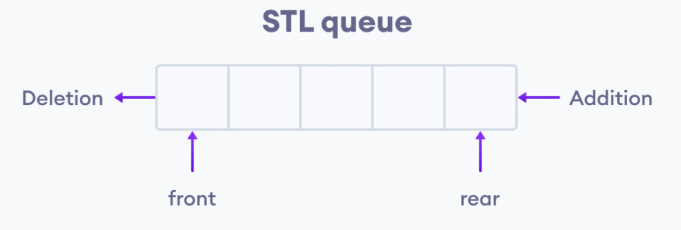
What is a Queue?
The queue data structure follows the “FIFO” (First In First Out) principle where elements that are added first will be removed first.
Inserting elements will add to the end of the queue, while removing elements will remove from the front of the queue, think of it as getting in line for something!
First come, first served!
Most commonly implemented using Linked Lists or the STL C++ Library

Slide 15
What are Priority Queues?
Priority Queues act the same as normal ones, except now the order of the queue is based on priority
Elements with a “higher” priority are put at the front of the queue
Elements with a “lower” priority are put at the end of the queue
Elements with the same priority are added to the queue based on which one was added first
Go hand in hand with heaps, which will be discussed later

Slide 16
Sorting Algorithms

Slide 17
What to Know
Merge, Quick, Shell, Bucket, and Heap Sort
Code Implementations
Tracing
Best/Worst Time Complexities

Slide 18
What is Merge Sort?
The Merge Sort algorithm uses the “divide and conquer” method where we divide the problem into subproblems and solve the subproblems individually.
Subproblems are then combined to form the final solution!
Merge Sort specifically divides a given array into two equal halves and then they are combined in a sorted manner.
Basically though, keep splitting the array in half until each sublist has 1 element, then merge everything back together in a sorted manner

Slide 19
What is Quick Sort?
As the name suggests, quick sort is a relatively fast divide and conquer sorting algorithm.
In quick sort, we pick a pivot element (there are many variations of quick sort, but for the sake of this class, we’ll be picking the last element of an array as the pivot element).
We want to position the pivot in a place where all elements to the left of it are of less value than the pivot, and where all elements to the right of it are greater than the pivot.

Slide 20
What is Shell Sort?
The Shell sort algorithm in a sense, is a variation of Insertion sort.
Sometimes in Insertion Sort, in order to get an element in its correct sorted position, many shifts are required to do be done to do so. Shell sort aims to reduce these number of operations by comparing elements that are far apart first and gradually reducing the gap between elements to perform smaller, more frequent swaps.
In Shell sort, we use a gap value to make sublists (with the intervals between each value being the gap value).

Slide 21
What is Bucket Sort?
Bucket Sort does digit by digit sorting, starting from least significant digit, to most significant digit.
For every iteration of the bucket sort (will iterate for the max number’s number of digits), we’ll generate 10 buckets (implemented as queues). We’ll add numbers to their respective bucket depending on the digit’s value.
We’ll be using these buckets to sort these values, digit by digit. If any of this seems confusing, look at the hand tracing of the sort for clarification.

Slide 22
What is Heap Sort?
In Heap sort, we visualize the elements of the given array as a binary tree, which is called a heap.
General Idea of Heap Sort:
Build a max/min heap from input (array)
Max/min value should now be at root node. Replace it with last item in heap and reduce heap size by 1. Then “heapify” root of tree.
Repeat (2) while size of heap is greater than 1

Slide 23
Best/Worst Case Time Complexities
Merge Sort → Best = O(n * log(n)) | Worst = O(n * log(n))
Quick Sort → Best = O(n * log(n)) | Worst = O(n^2)
Shell Sort → Best = O(n * log(n)) | Worst = O(n^2)
Or (O(n * log(n)^2)) for worst case, go with whatever TA’s say
Bucket Sort → Best = O(n + k) | Worst = O(n^2) [n = size of array, k = number of buckets]
Heap Sort → Best = O(n * log(n)) | Worst = O(n * log(n))

Slide 24
Heaps

Slide 25
What To Know
Build Max/Min Heap
Performing Heap Sort

Slide 26
Heaps
Heaps are a special tree-shaped data structure in which the tree is considered complete (a binary tree in which all the levels are completely filled except possibly the lowest one, which is filled from the left).
It as well must satisfy the heap property:
Max Heap: any given node is always greater than its child node/s and the key of the root node is the largest among all other nodes
Min Heap: any given node is always smaller than its child node/s and the key of the root node is the smallest among all other nodes

Slide 27
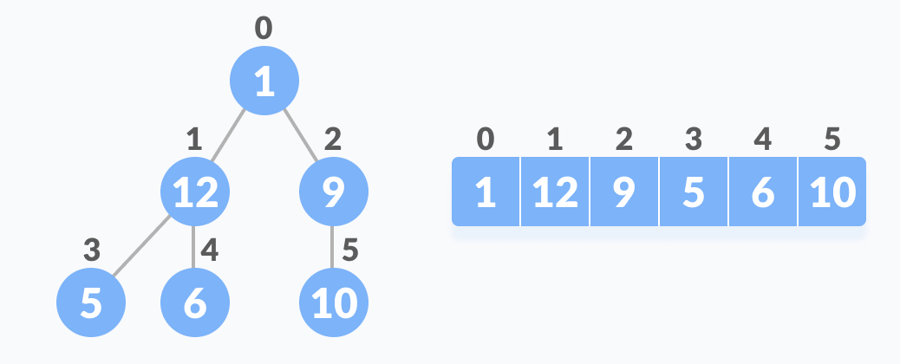
Relationship Between Array Indexes and Tree Elements
A complete binary tree has an interesting property that we can use to find the children and parents of any node.
If the index of any element in the array is i:
Parent Node Index → (i - 1) / 2
Left Child Index → 2i + 1
Right Child Index → 2i + 2

Slide 28
Hashing

Slide 29
What To Know
Direct, Linear, Quadratic, and Double Hashing and Separate Chaining
Code Implementations
Tracing

Slide 30
Hashing Techniques
Direct Hashing: Inserts key into hash table without checking for collisions/doing anything about collisions​ (data is overwritten in this case)
Linear Probing: After collision occurs, linearly look for next available index in the hash table where the key can be mapped to
Quadratic Probing: Follows the same idea as linear probing, but now instead of linearly looking for next available index in the hash table when a collision occurs, we’ll iterate by i^2
Double Hashing: When a collision occurs, we use a second hash function to find an empty index in our hash tables
Separate Chaining: Pointers to linked lists; append to beginning/end of the linked list in each respective hash index as needed

